Slide 1
Ultra-Wide Band Localization
Hakan Karadeniz
Akın Bora Kılıç
July 5th , 2022
EEEN 492 Project Presentation
Notes:
1

Slide 2
Problem Statement
Problem defination
Why it is important ?
The aim and objective of project
7/5/2022
2
Notes:
2

Slide 3
Web Based Method of Literature Search
Resource | Web Adress
Search Enginees
Google | http://www.google.com
Google Scholar | http://www.scholar.google.com
Electronic Search of Database
Product Brief | https://www.decawave.com
DWS1000 & DWS3000 Schematics | https://www.decawave.com
DWS3000 API Software and API Guide | https://www.decawave.com
DWM3000EVB Quick Start Guide | https://www.decawave.com
UM 1974 User Manual (Stm32) | https://www.st.com
STM32CubeIDE | https://www.st.com
Ac6 Tools | https://www.ac6-tools.com
OpenOCD Debugger | https://openocd.org/
Forum | https://community.st.com/
Forum | https://decaforum.decawave.com/
Forum | https://github.com/
7/5/2022
3
Notes:
3

Slide 4
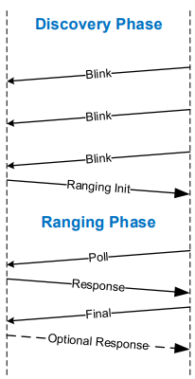
Two-Way Ranging Process

Slide 5
LOCALIZATION
Antenna
PDoA.exe
Antenna Locations

Slide 6
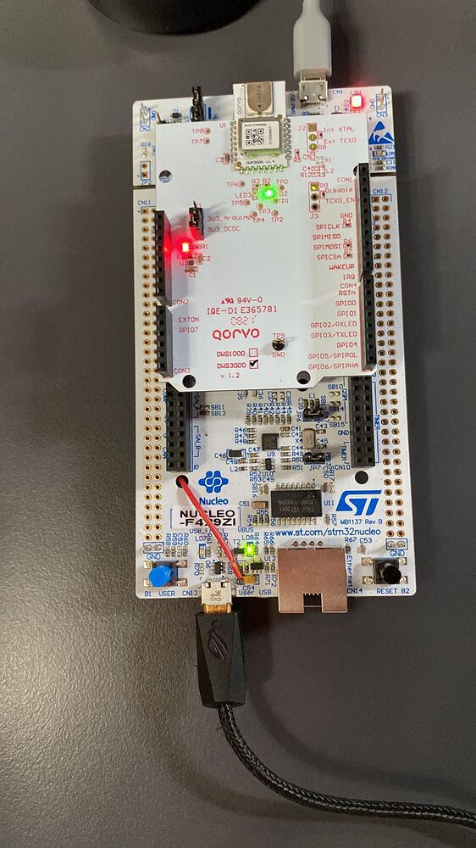
Antenna

Slide 7
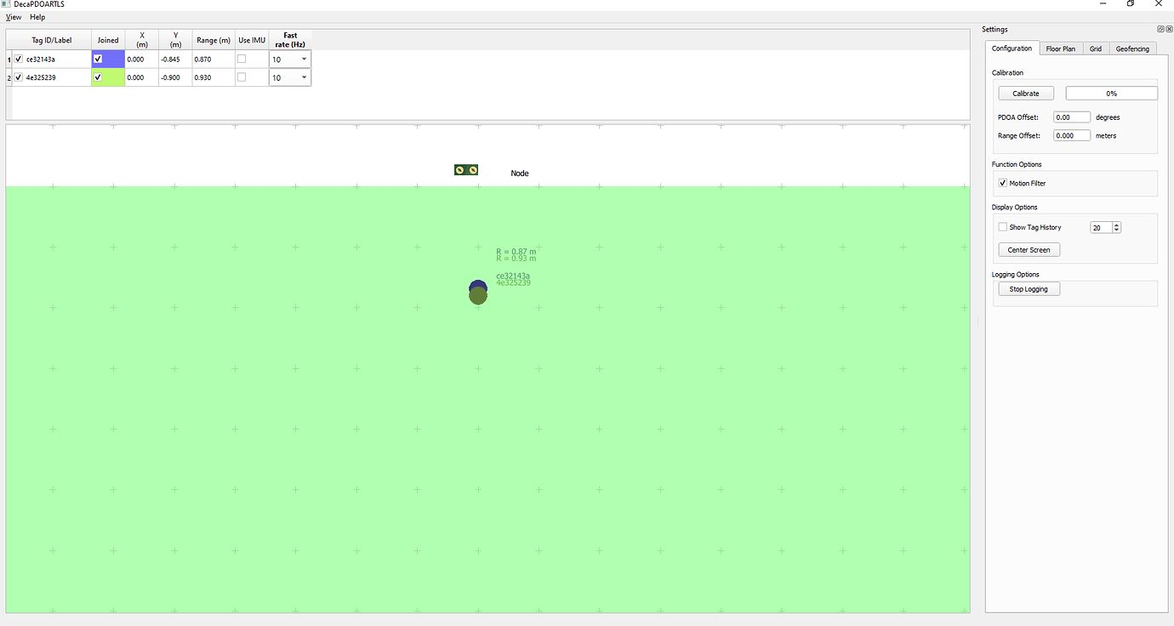
PDoA.exe

Slide 8
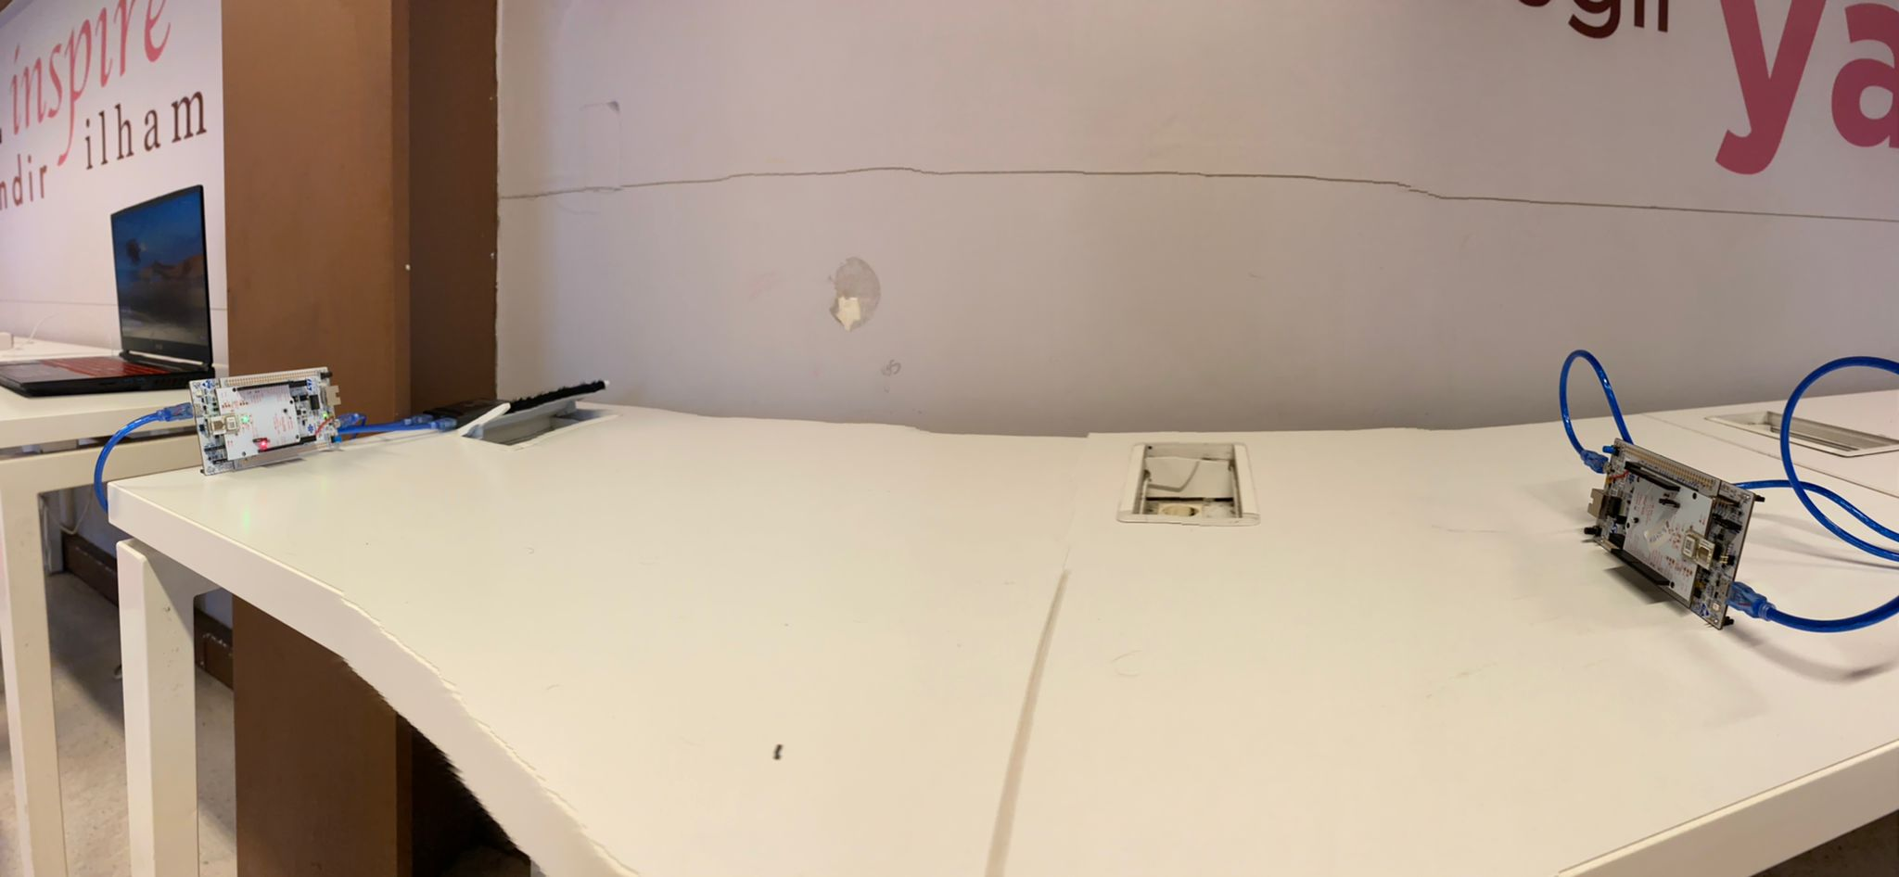
Antenna Locations
Eklemeyi unutmaaa

Slide 9
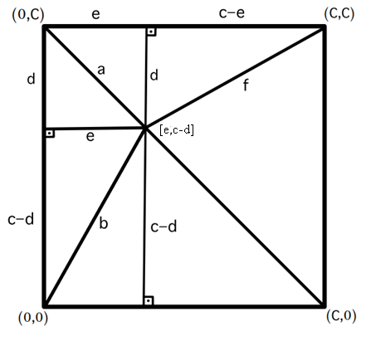
Calculations
Y-Axis
e² + d² = a²
e² + (c – d)² = b²
- e² - d² = - a²
e² + c² – 2cd + d² = b²
c² – 2cd = b² – a²
d = b² – a² - c² / - 2c
X-Axis
e² + d² = b²
e² = b² – d²
e = √ b² – d²
a and b value coming from .exe
c value coming from user

Slide 10
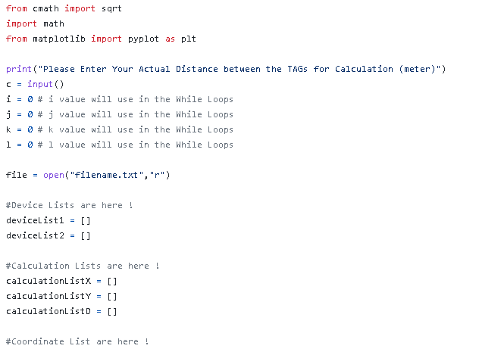
<CODE>
Libraries
« C « Value
i,j,k,l Values
file.open
device.list

Slide 11
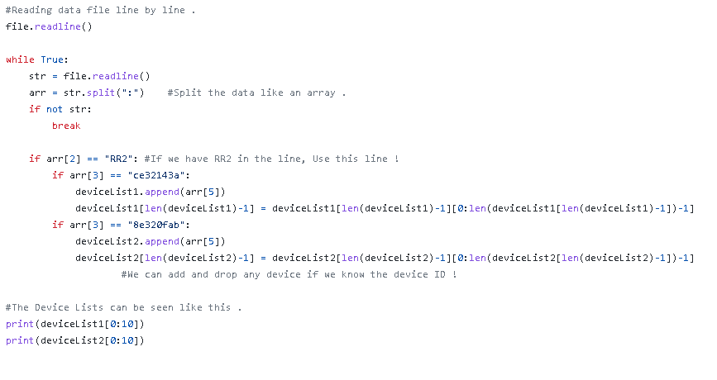
<CODE>
file.readline
arrays
print devicelist

Slide 12
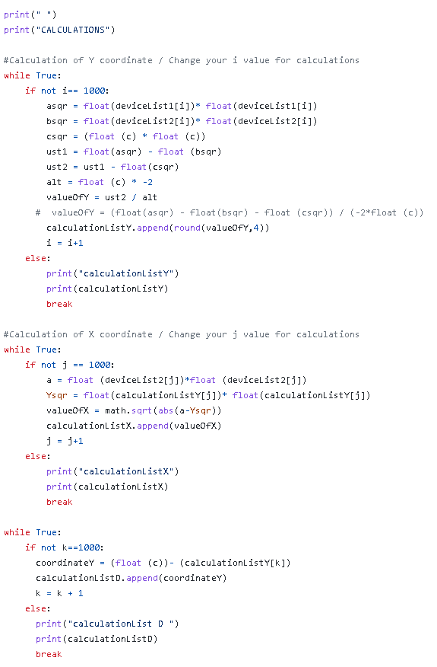
<CODE>
x = d Value
y = e Value
append list

Slide 13
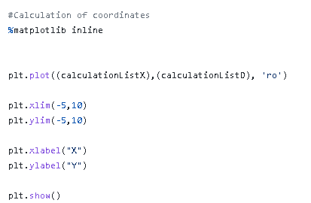
<CODE>
matplotlib
plot ‘ro’
x-lim
y-lim
show

Slide 14
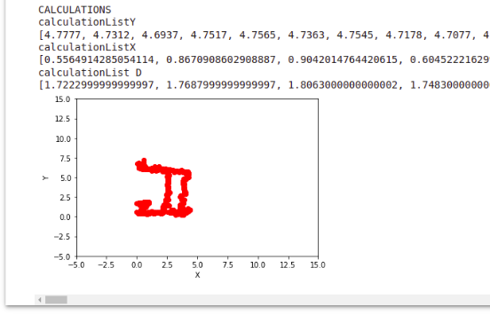
Test Result

Slide 15
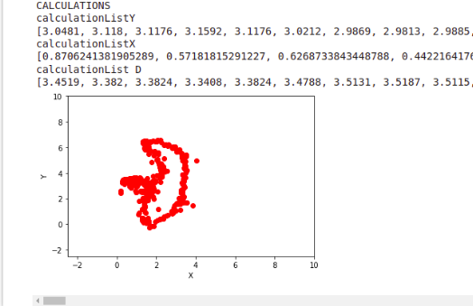
Test Result

Slide 16
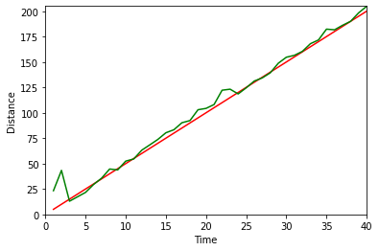
Test Error
The measurements made for each "5 centimeters" were averaged. The work continued until the length of "2 meters". As can be seen in the graph, the most deviation occurs on the first "15 centimeters".
MAPE = 21.421501615868394 OK!
(THE ANTENNAS OF THE DEVICES ARE LOOKING AT EACH OTHER WHEN THIS MEASUREMENT IS MADE )

Slide 17
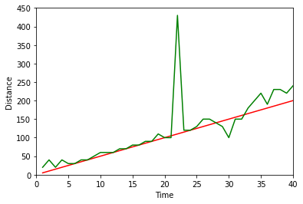
Test Error
. The measurements made for each "5 centimeters" were averaged. The work continued until the length of "2 meters
MAPE = 34.09314155845813
(WHEN THIS MEASUREMENT IS MADE, THE ANTENNAS OF THE DEVICES ARE LOOKING TO EACH ONE)

Slide 18
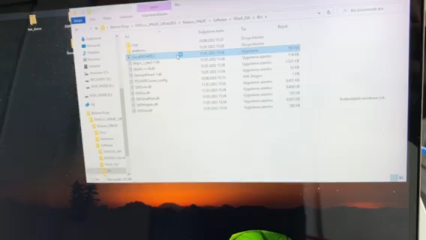
Conclusion
7/5/2022
18

Slide 19
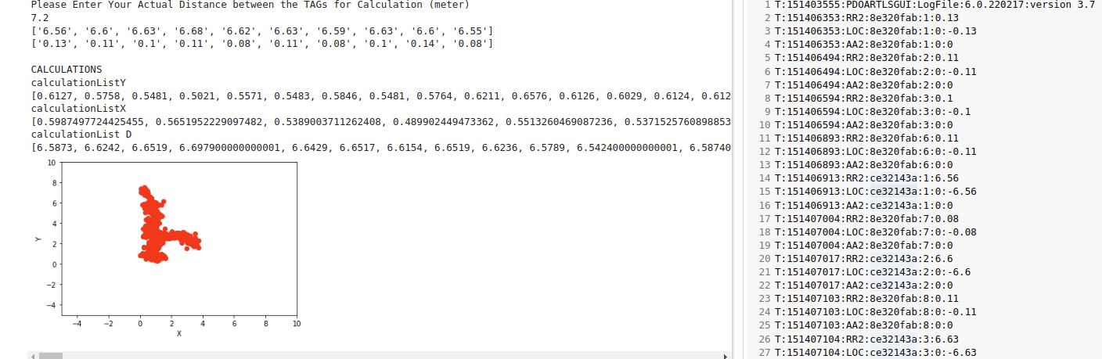
Conclusion
7/5/2022
19

Slide 20
Futurework
Real-Time
More stabile
More effieceny
7/5/2022
20

Slide 21
Thank you for your attention
7/5/2022
21

Slide 22
Additional slides for Q&As
7/5/2022
22

